Slide 1
COBOL-DB2 PROGRAMS
DB2 Training class 05

Slide 2
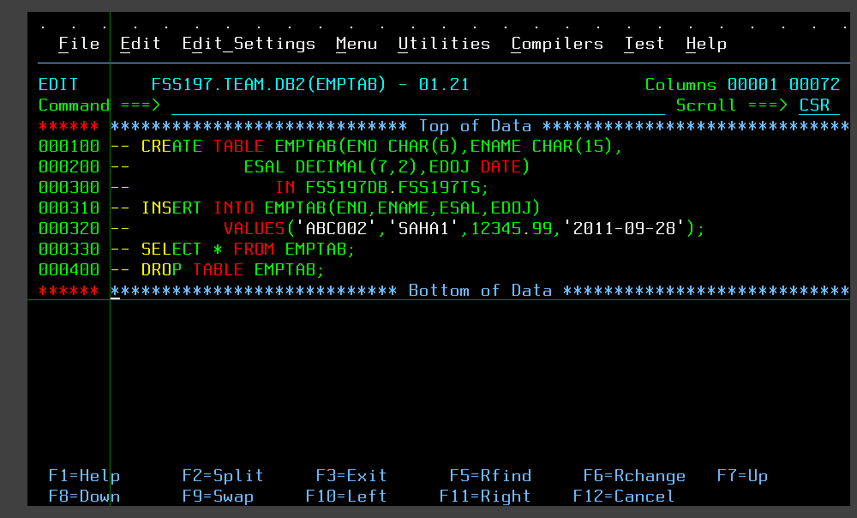
SPUFI SCREEN

Slide 3
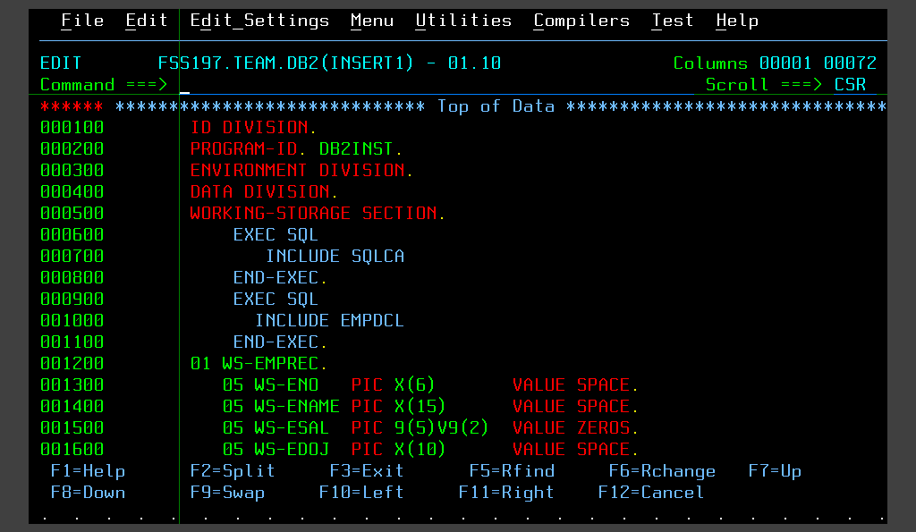
INSERT PROGRAM

Slide 4
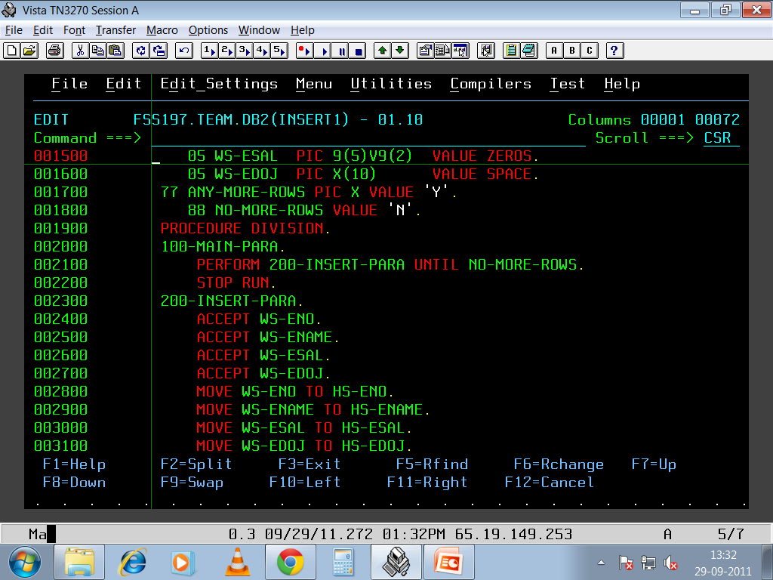
INSERT PROGRAM

Slide 5
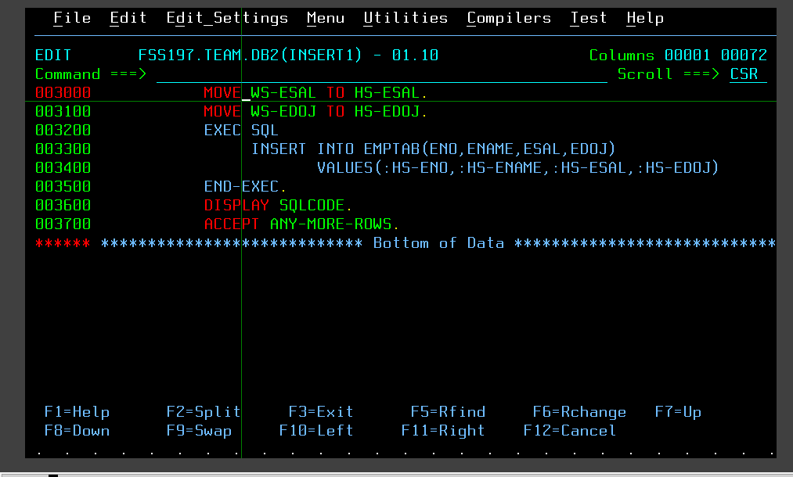

INSERT PROGRAM

Slide 6

SELECT PROGRAM

Slide 7
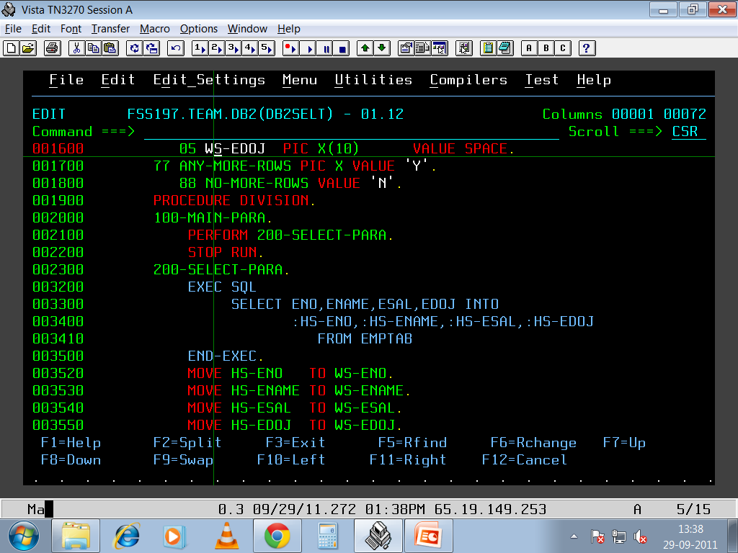
SELECT PROGRAM

Slide 8
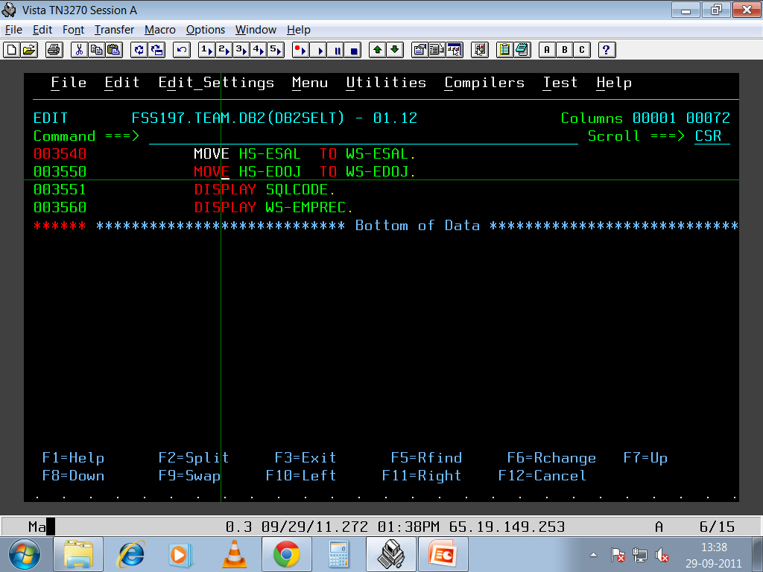
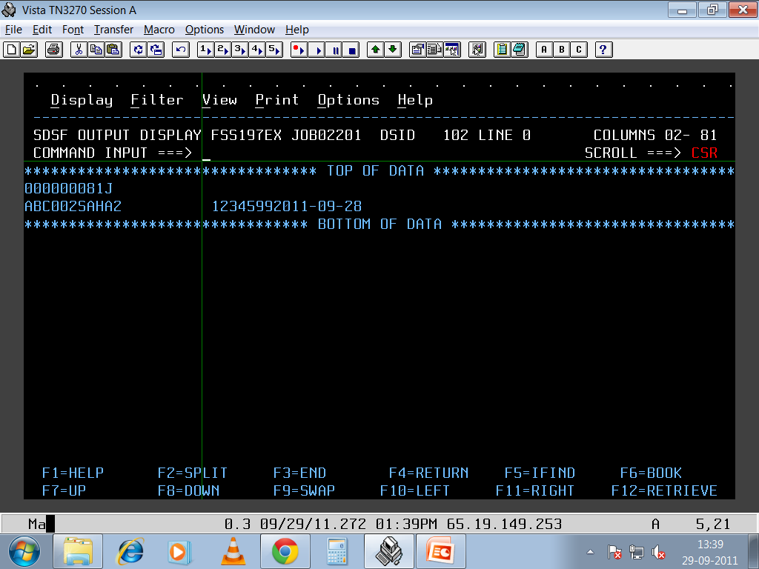
SELECT PROGRAM
SYSOUT OUTPUT SQLCODE = -811

Slide 9
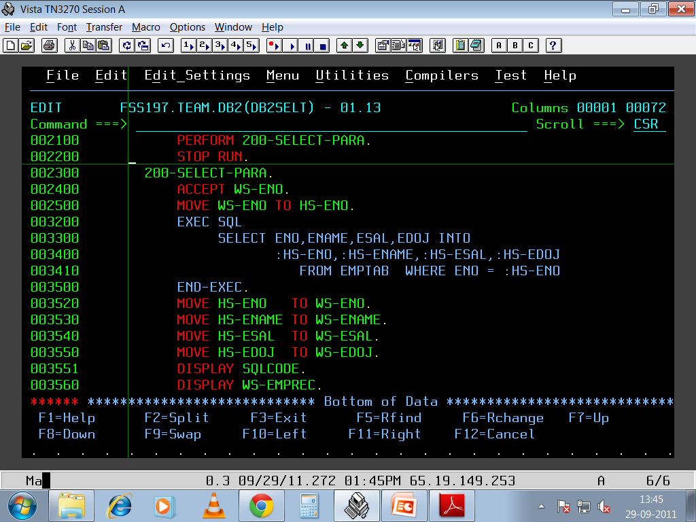
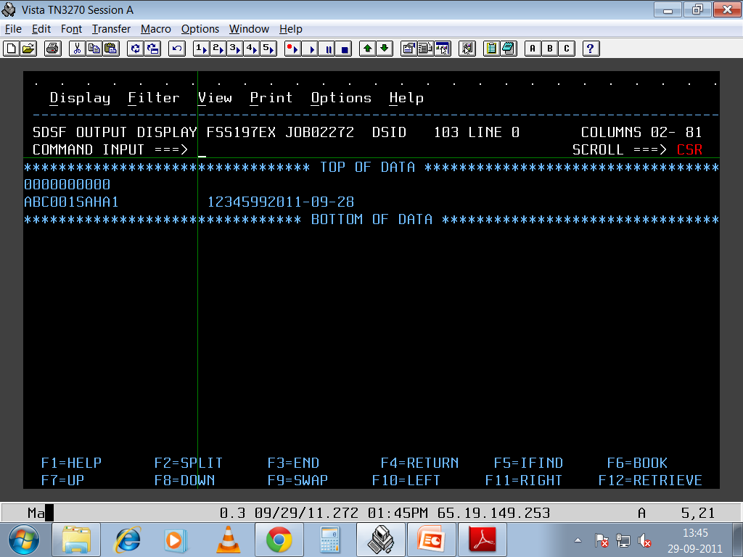
SELECT WITH WHERE CONDTITION
SYSOUT OUTPUT

Slide 10
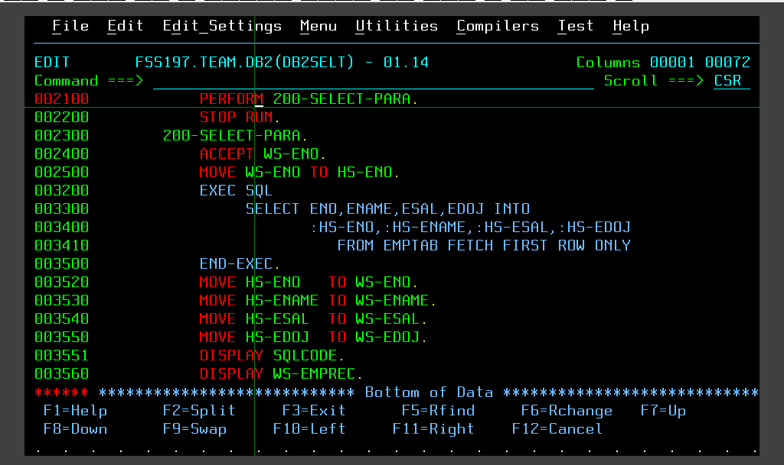
SELECT WITH FETCH FIRST

Slide 11
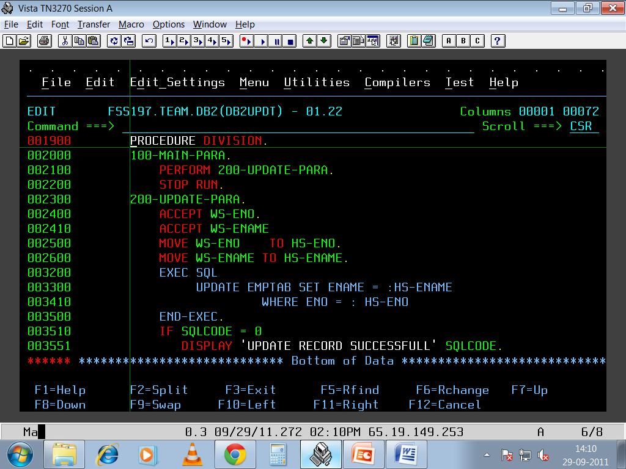
UPDATE PROGRAM

Slide 12
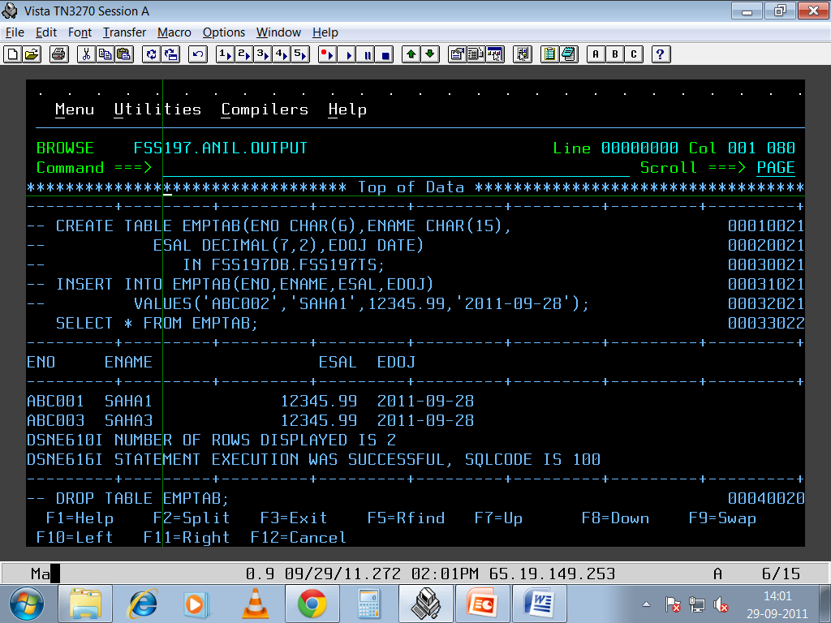
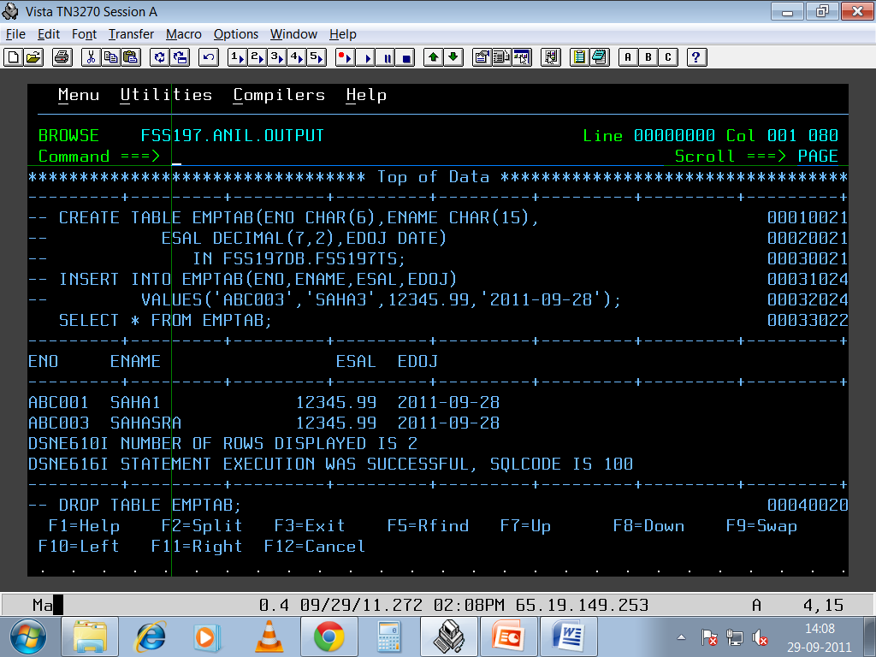
UPDATE OUTPUT BEFORE AND AFTER

Slide 13
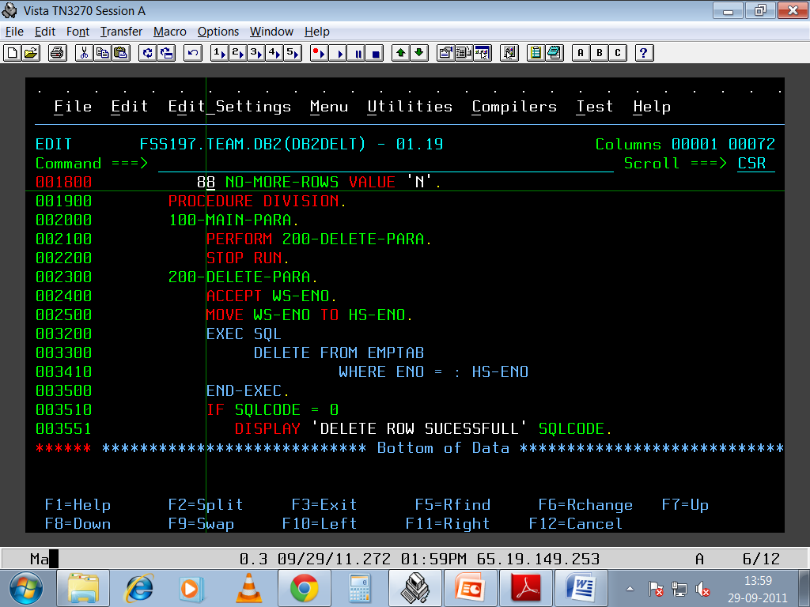
DELETE PROGRAM

Slide 14
Thank You

